Slide 1
Fully featured website for frappe company (Dan’s Frappe Hell) including: point of sale, inventory and user management
Group 6
Wesley Edwards: Front End Specialist
Joshua McClung: Back End Specialist
Landon Doyle: User Testing Specialist
Geoffrey Haselden: Unit Testing Specialist

Slide 2
Overview
Design Decisions
Use of Scrum
Ready for Deployment

Slide 3
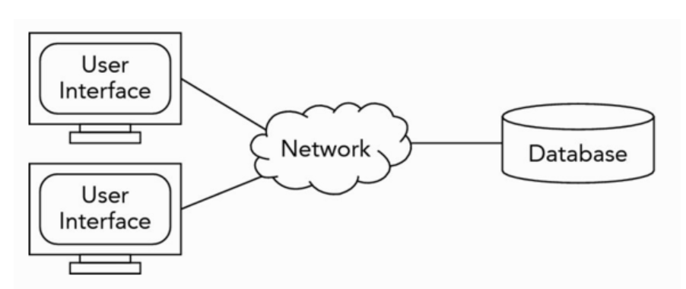


Design Decisions
Two-tier Architecture
Back-end:
Data Management, Database
Flask Framework
Python
Front-end:
User Interface
React-JS Framework
TypeScript
Back-end and Front-end are completely separate and served off of different ports
We chose this architecture and tools because:
They scale well for the scope of the project
Are commonly used in modern web-development
We were relatively familiar with them

Slide 4
Use of Scrum
Separated groups into two teams
Front-end: Landon, Wesley
Back-end: Josh, Geoffrey
Scrum helped communicate between teams
Kept us working on it consistently.

Slide 5
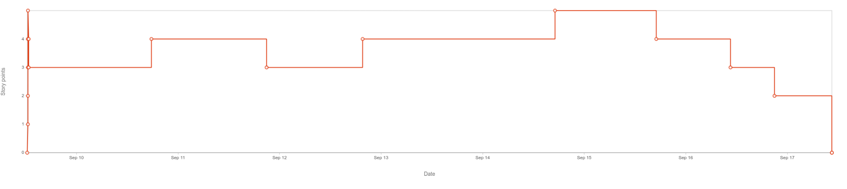
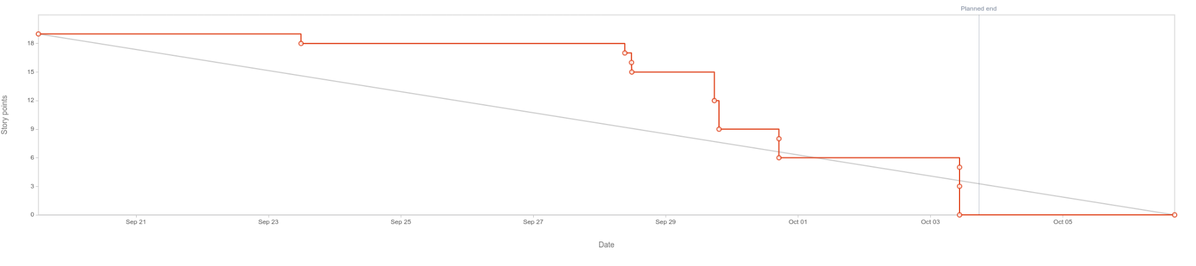
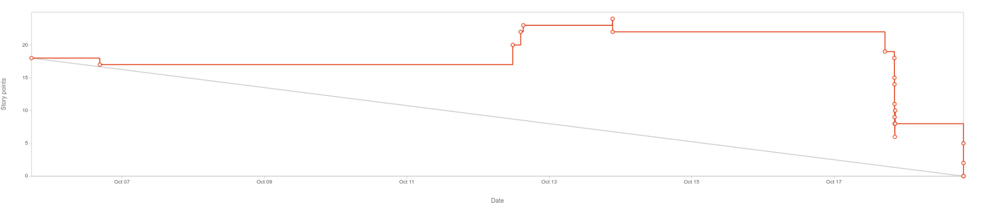
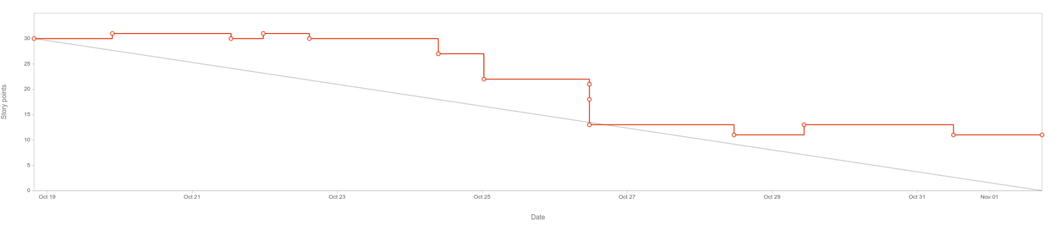
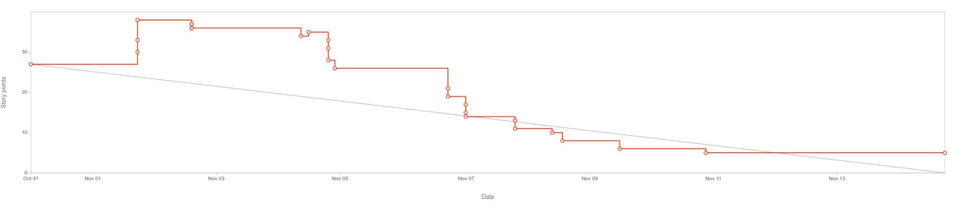
Burn-down Chart
Requirements Gathering
High-level Design
Low-level Design
Development
Testing

Slide 6
Ready for Deployment
Why it is ready for deployment:
There are no obvious bugs
Product is tested and correctly Implemented (Especially security)
Customer is happy with the current state of the project.

Slide 7
Requirements Tracing
Auth
POS
Managerial Functionality

Slide 8
Requirements Tracing - Auth
Requirement 1.1 in Requirements.txt
“1.1 System must require all users to authenticate before accessing system functions/features”
FURPS
Falls under Functionality, more specifically a security requirement
MOSCOW
This is a “must” requirement

Slide 9
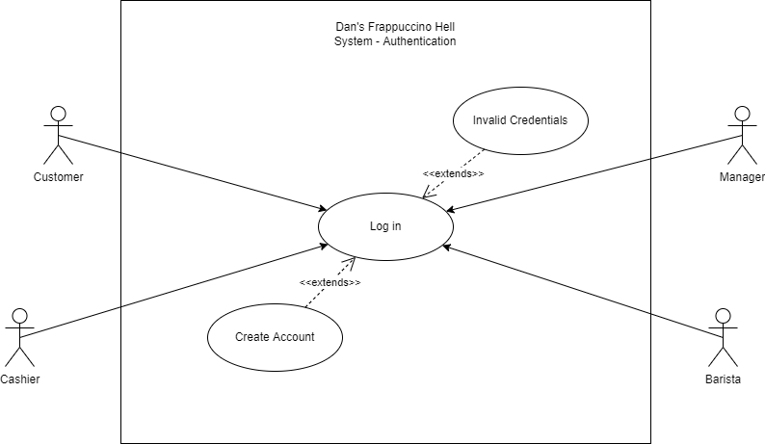
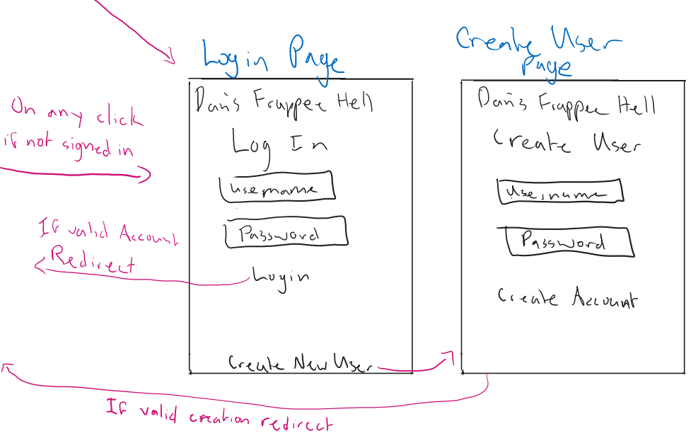
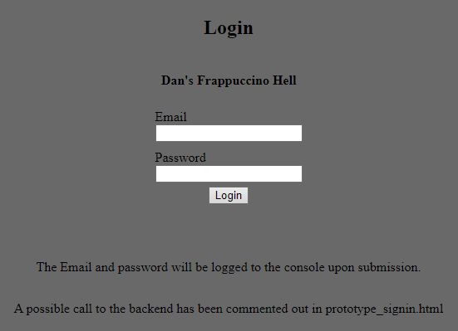
Requirements Tracing - Auth
UML
Lo-Fi
Hi-Fi
Notes:
These are the various models used in designing this feature. We followed a fairly simple authentication scheme that is common amongst most apps. The reason we did this was to make the app as usable as possible.

Slide 10
Requirements Tracing - Auth
Josh
CS3450-28 Create Token Check function
Geoffrey
CS3450-26 Add user Model
Wesley
CS3450-32 Login UI
CS3450-52 Create Account UI
Landon
Notes:
The Codes in front of the written description are the ticket numbers for the issues related to this requirement. All 3 requirement slides will follow this format

Slide 11
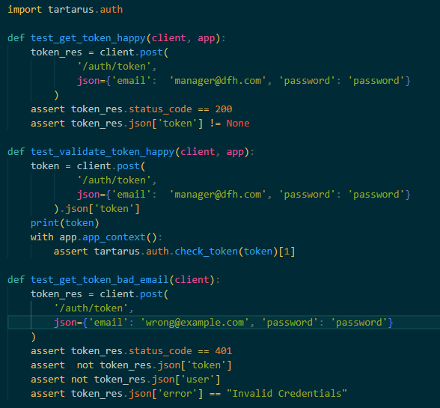
Requirements Tracing - Auth
Unit Testing
Pytest suite for running tests
Executed by invoking `pytest` command
Test environment is automatically created and destroyed as needed
Auth tests specifically located in test_auth.py
Manual Testing
Testing UI was done manually by entering values into the fields

Slide 12
Requirements Tracing - POS
Requirement 4.1 in Requirements.txt
“4.1 There must exist a customer-facing POS functionality for a customer to order their own drinks”
FURPS
Falls under Functionality
MOSCOW
This is a “must” requirement

Slide 13
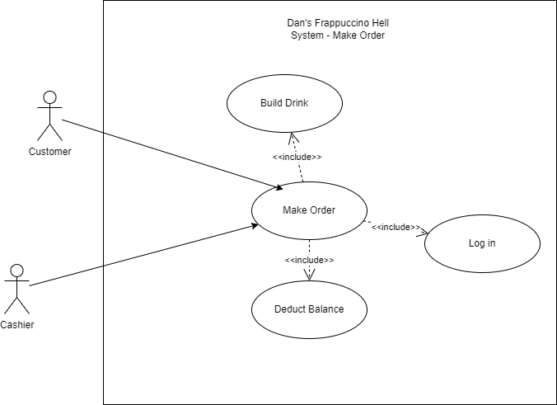
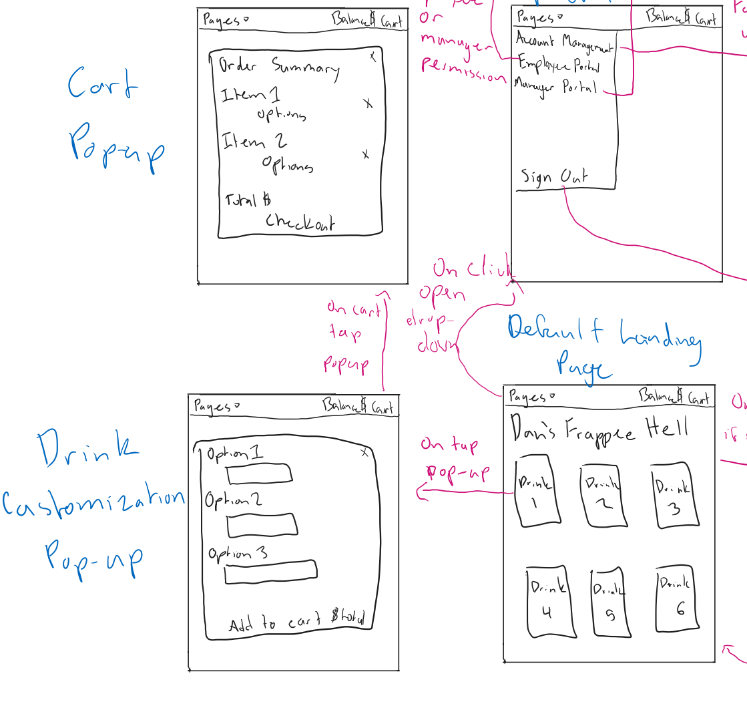
Requirements Tracing - POS
UML
Lo-Fi
Notes:
These are the various models used in designing this feature. We followed a fairly simple authentication scheme that is common amongst most apps. The reason we did this was to make the app as usable as possible.

Slide 14
Requirements Tracing - POS
Josh
CS3450-29 Implement Balance Model
CS3450-30 Create Drink Model
CS3450-33 Create Inventory Model
CS3450-71 Hook up Balance to order flow
Geoffrey
Wesley
CS3450-70 Add Custom Drink Functionality
CS3450-81 Handle insufficient fund errors from backend
Landon
CS3450-24 Create Landing Page
CS3450-35 Create Drink Card Popup
CS3450-53 Landing Page Functionality

Slide 15
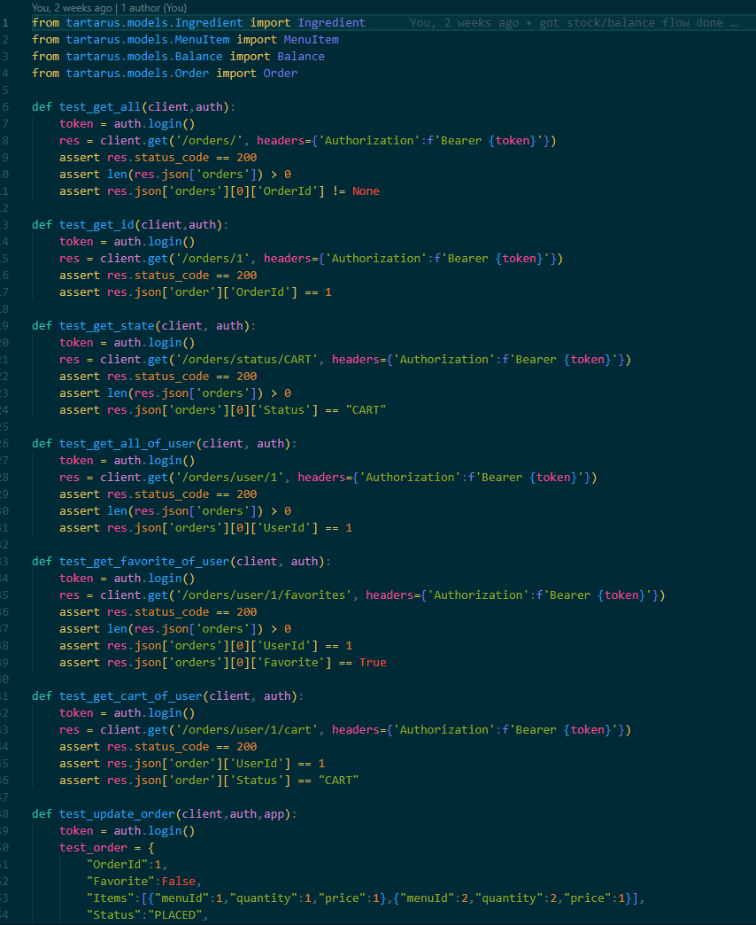
Requirements Tracing - POS
Unit Testing
Pytest suite for running tests
Executed by invoking `pytest` command
Test environment is automatically created and destroyed as needed
Tests for Order Flow are in:
test_balance.py
test_menuitems.py
test_orders.py
Manual Testing
Testing UI was done manually by entering values into the fields
Notes:
Tests are located in the tarturus/tests/ directory in the git project

Slide 16
Requirements Tracing - Managerial Functionality
Requirement 6.2 in Requirements.txt
“6.2 There must exist a payroll system”
FURPS
Falls under Functionality
MOSCOW
This is a “must” requirement

Slide 17
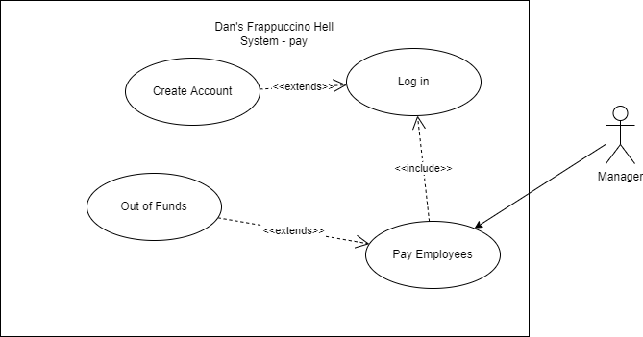
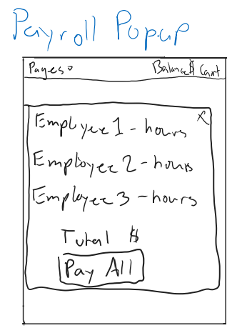
Requirements Tracing - Managerial Functionality
UML
Lo-Fi
Notes:
These are the various models used in designing this feature. We followed a fairly simple authentication scheme that is common amongst most apps. The reason we did this was to make the app as usable as possible.

Slide 18
Requirements Tracing - Managerial Functionality
Josh
CS3450-29 Implement Balance Model
Geoffrey
CS3450-32 Create Employee Model
CS3450-46 Create Friday Button Endpoint
Wesley
CS3450-76 Employee Hour Page
Landon
CS3450-40 Payroll Page

Slide 19
Requirements Tracing - Managerial Functionality
Unit Testing
Pytest suite for running tests
Executed by invoking `pytest` command
Test environment is automatically created and destroyed as needed
Tests for Paying Employees are in test_balance.py
Manual Testing
Testing UI was done manually by entering values into the fields
Notes:
Tests are located in the tarturus/tests/ directory in the git project

Slide 20
Resources
https://flask.palletsprojects.com/en/2.2.x/
https://mui.com/
https://docs.pytest.org/en/7.2.x/contents.html
https://reactjs.org/docs/getting-started.html
https://www.atlassian.com/software/jira

